Slide 1
Psychological Perspectives

Slide 2
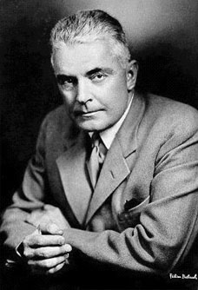
Behaviorism
John B. Watson
“Science of behavior”
Observable, measurable, ________

Slide 3
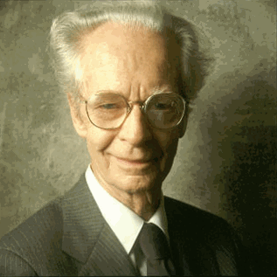
Behaviorism
Popularized by B.F. Skinner

Slide 4
Behaviorism (cont.)
Behavior is determined by factors in the environment.
No need to study the mind; study the environment that causes the behavior.

Slide 5

Behaviorism (cont.)
Skinner: Walden Two
Operant Conditioning/Skinner’s Box
Free will?!?

Slide 6
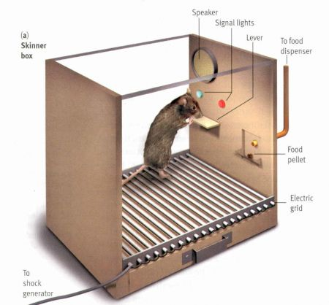

Slide 7
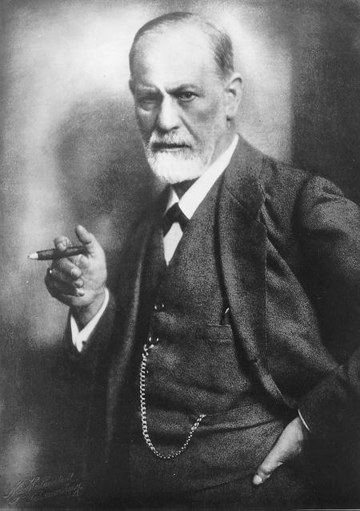
Psychoanalysis
Popularized by . . .

Slide 8
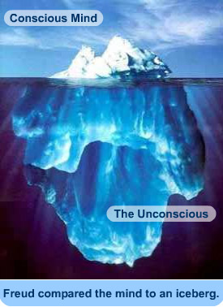
Psychoanalysis (cont.)

Slide 9
Psychoanalysis
You are controlled by unconscious impulses
Conflict between conscious/unconscious mental processes
Has recently diminished

Slide 10


Humanistic Psychology
Created as a response to ____ and ____.
Focuses on the uniqueness of human beings and their ability to make decisions.

Slide 11
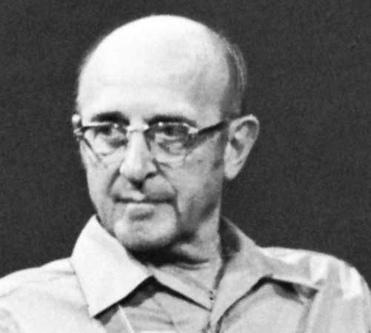
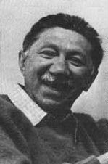
Humanistic Psychology
Popularized by Abraham Maslow and Carl Rogers

Slide 12
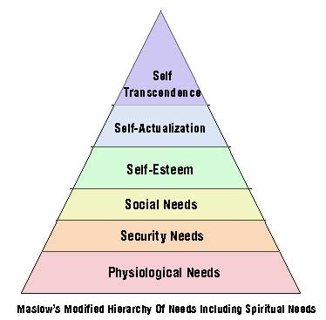

Slide 13
Humanistic Psychology
Promotes free will and positive view of human nature
Hierarchy of Needs
Promotes group therapy

Slide 14

Cognitive Psychology
Combination of ____ and ____
Studies mental processes

Slide 15
Cognitive Psychology
Gestalt Psychology
Information-Processing Theory

Slide 16
Gestalt Psychology
Individuals perceive objects as whole units rather than individual parts
Phi phenomenon

Slide 17


Slide 19


Slide 20
Information-Processing Theory
Thinking like a computer

Slide 21
Information-Processing Theory (cont.)
The old woman was sweeping the steps.

Slide 22

Information-Processing Theory
TIHAS CASLSROOM RCOKS
CNADY TSATES DLECIUOS
SHOCOL IS AEWSMOE

Slide 23
Cognitive Psychology Today
Solves problems with gender differences
Intelligence
One of the most prominent psych schools of thought

