Slide 1
Portrait of classes

Slide 2
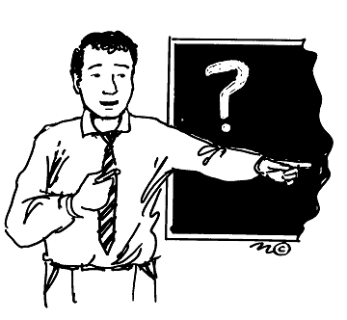

Slide 3
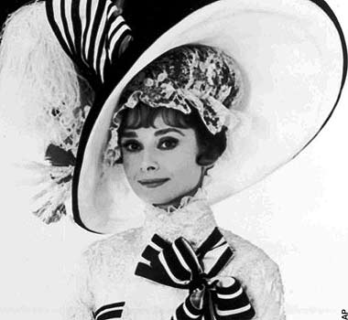

Slide 4
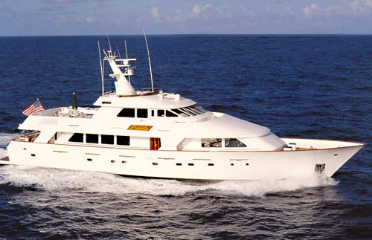

Slide 5
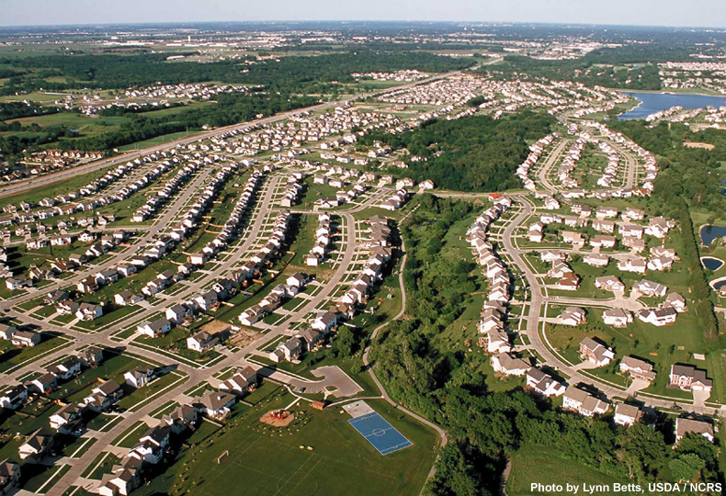

Slide 6
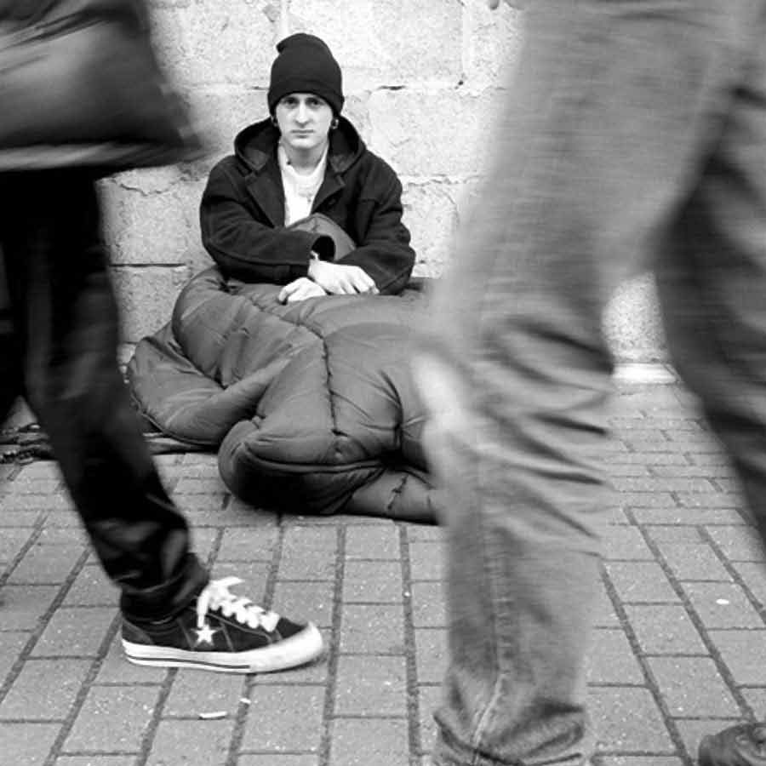

Slide 7
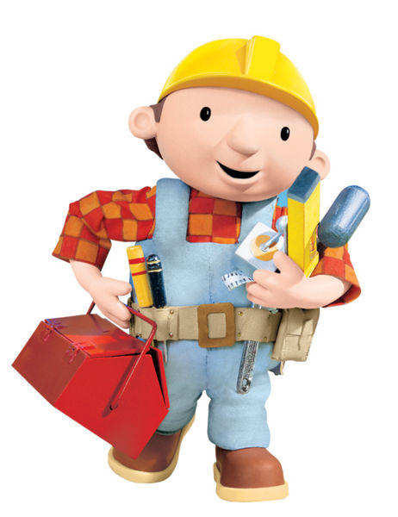

Slide 8
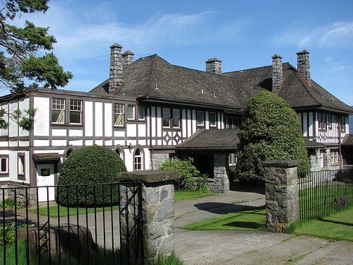

Slide 9
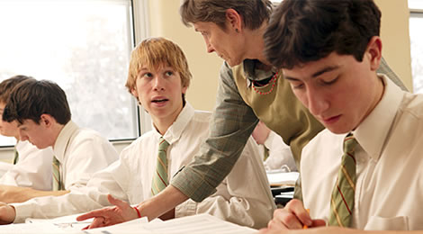
The Upper-Upper class
Small
Contains the richest and most powerful people of the land.
Like wine, must age a little

Slide 10
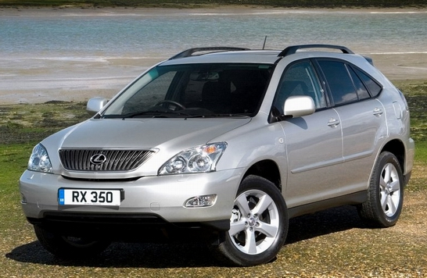
Lower-upper class
Those with “new” money
Better toys but lack the right “breeding”

Slide 11
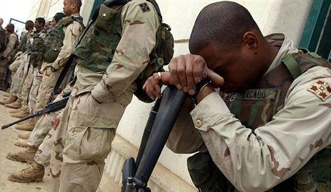
Upper class Influence
Foreign issues
Trade
Defense policies

Slide 12
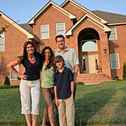
The upper-Middle class
High-income business and professional families
Race and religious affiliation?
Stable family life

Slide 13
Lower-middle class
Share the same values of upper-middle class
Average income people—not manual labor
Value hard work

Slide 14
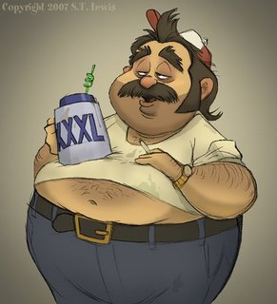
Working class
Do not consider themselves “lower class”
High % of nonwhites and less-educated people
Lack “fringe benefits”

Slide 15
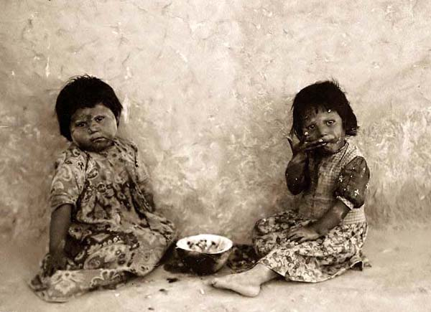
Lower class
“disreputable poor”
Textbook, “virtually worthless on the labor market, they are virtually worthless in terms of power and prestige.”
Fatalistic

Slide 16
Correlations between class and social characteristics
Political behavior
Marital stability
Religious affiliation
Educational Achievement
Health
Values and Attitudes
Child-rearing practices
Criminal behavior

Slide 17
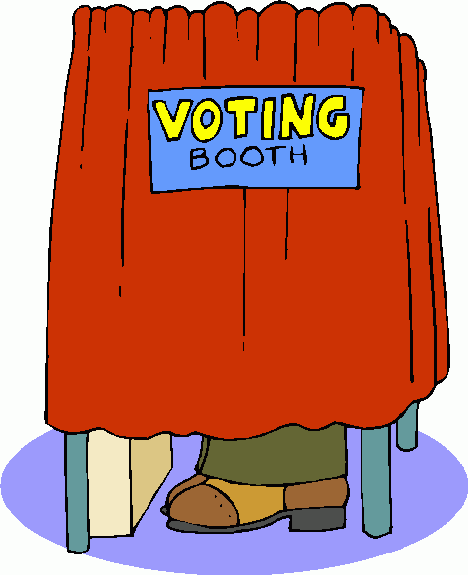
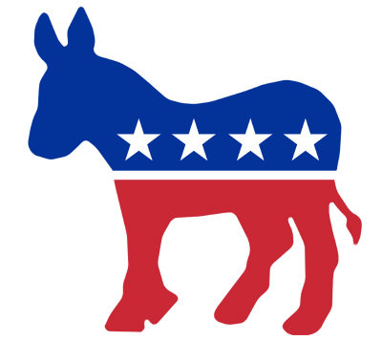
Political behavior

Slide 18
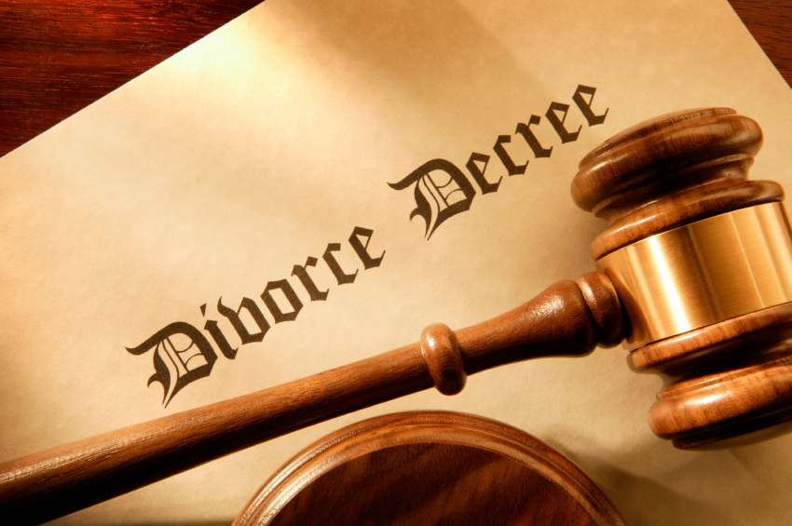
Marital stability

Slide 19
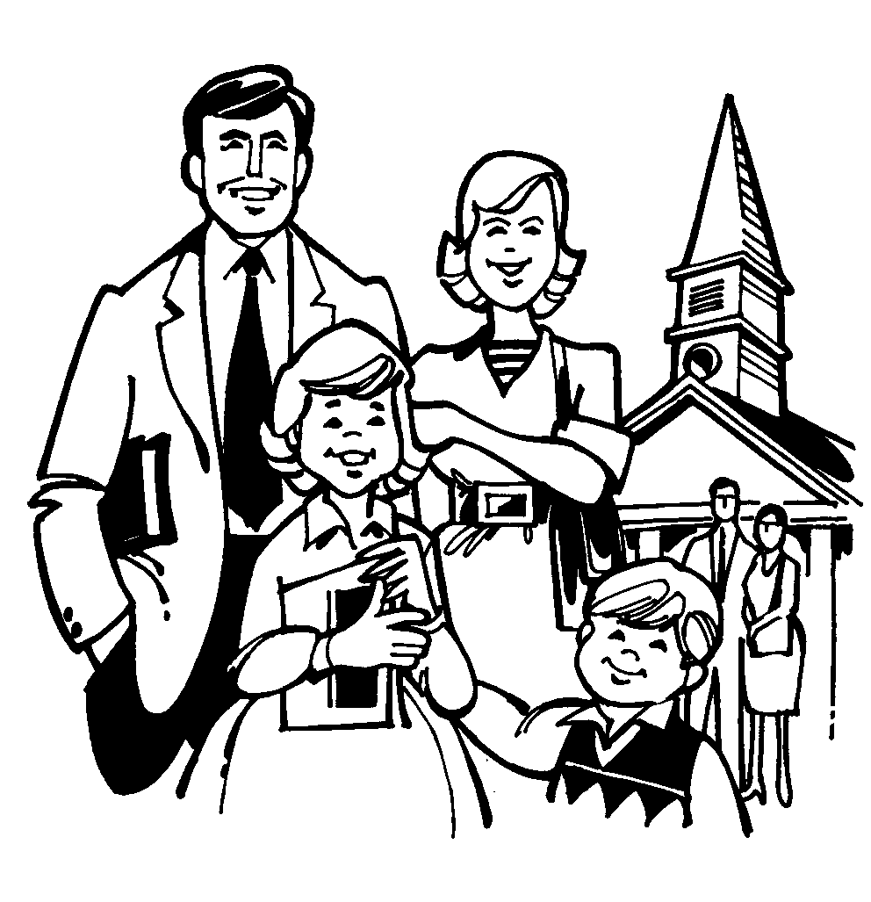
Religious affiliation

Slide 20
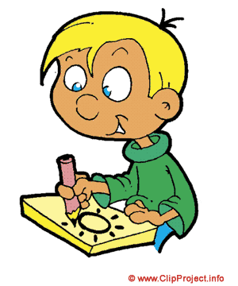
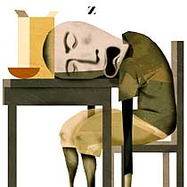
Educational Achievement

Slide 21
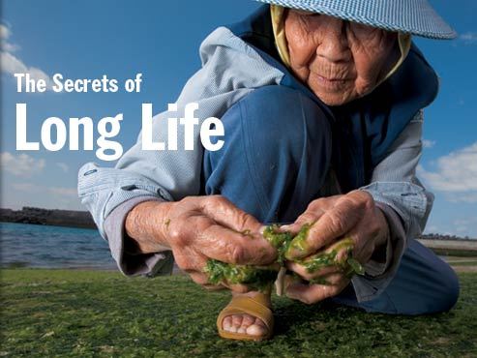
Health

Slide 22
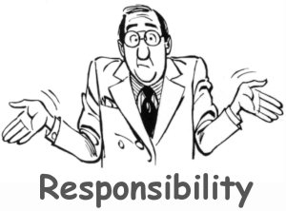
Values and Attitudes

Slide 23
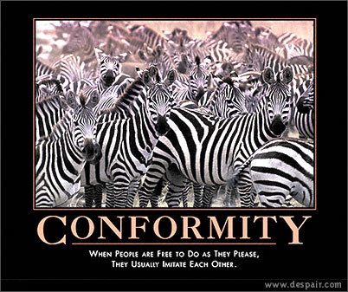
Child-rearing practices

Slide 24
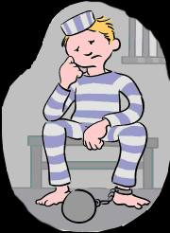
Criminal behavior

Slide 25
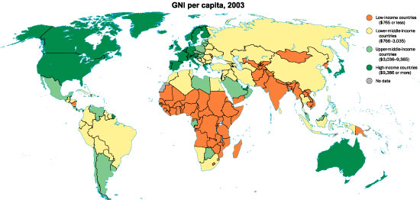

Slide 26
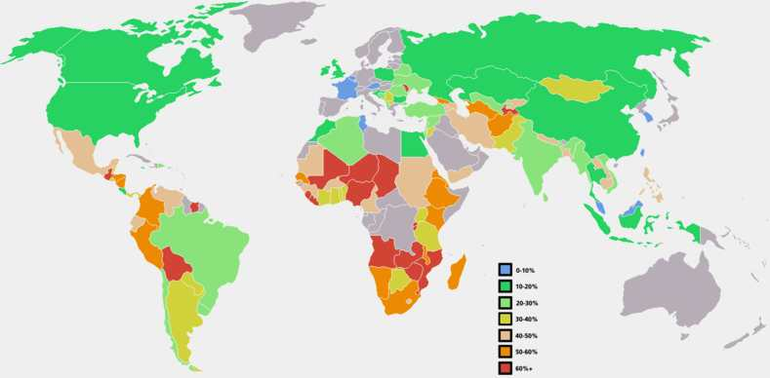
Global Poverty

Slide 27
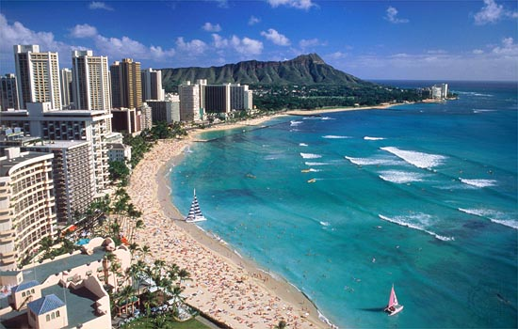
Global Wealth and poverty
Are all people in low income nations poor?

Slide 28
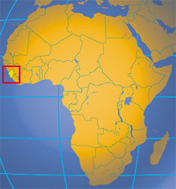
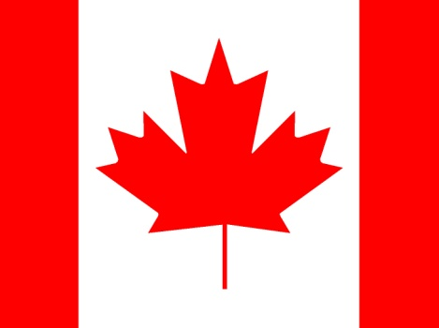
Severity of poverty
What country has the highest quality of life?
What country has the lowest quality of life?

Slide 29
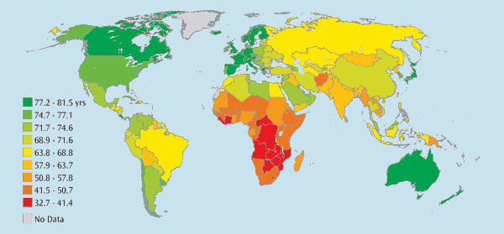
Life Expectancy

Slide 30
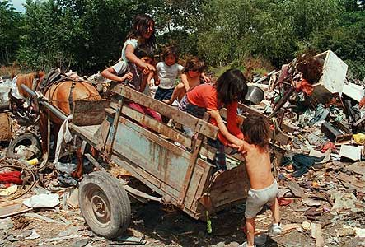
Relative poverty vs. Absolute poverty
Relative—some people lack resources others take for granted
Absolute—lack of resources that is life threatening

Slide 31
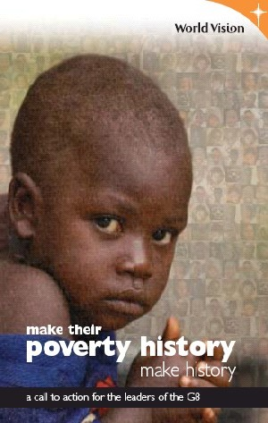
Extent of poverty
Where is poverty the greatest?
Worldwide—at any given time—____% of people suffer from chronic hunger.
________ people die a day because of an inadequate diet.

