Slide 1
Iran
Culture and History

Slide 2
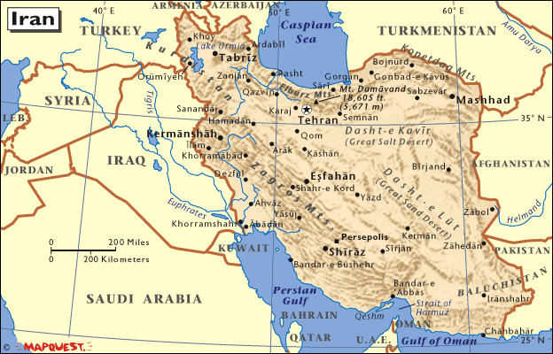
Key Terms
Shah – emperor
Ayatollah – expert in Islamic studies
Supreme Leader – the true leader in Iran

Slide 3
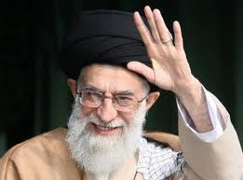
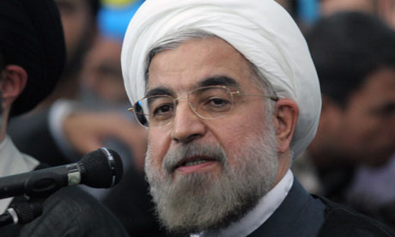
Current Leaders
Supreme Leader - Sayyed Ali Khamenei
President - Hassan Rouhani

Slide 4
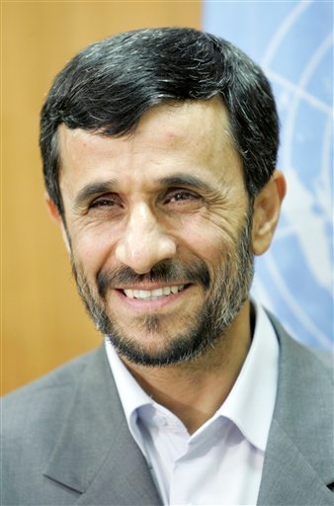
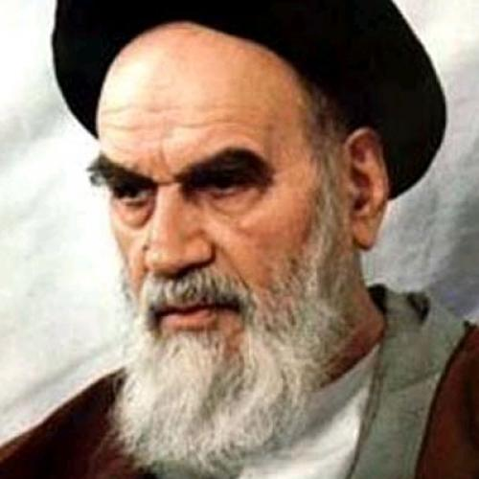
Past Leaders
Supreme Leader - Ayatollah Khomeini
President - Mahmoud Ahmadinejad

Slide 5
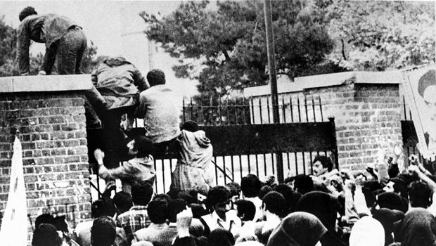
History
Persian Empire
Iranian Revolution – 1979
Period of distrust

Slide 6
Culture
Persian vs. Arabian
Religion – Large Majority Shiah Muslim
Similarities to the U.S.?

Slide 7
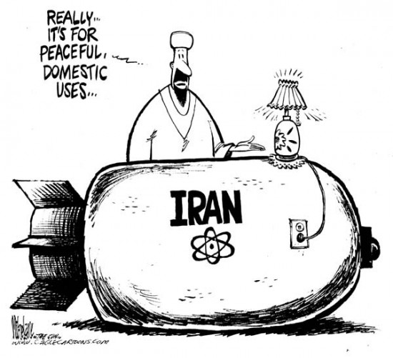
Iran Today
Nuclear Weapons/Energy Program?
Israeli/Palestinian Conflict – Hamas
Syrian Civil War

