Slide 1
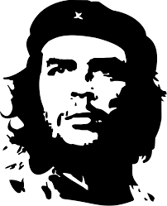
Che Guevara
Latin American Hero

Slide 2
Most Famous For . . .
Aiding Fidel Castro in the Communist revolution of Cuba in 1959.
Overseeing political prisoners following the revolution in Cuba.
Initiating the relationship between Cuba and the Soviets
Attempting to spread Communism throughout Latin America.

Slide 3
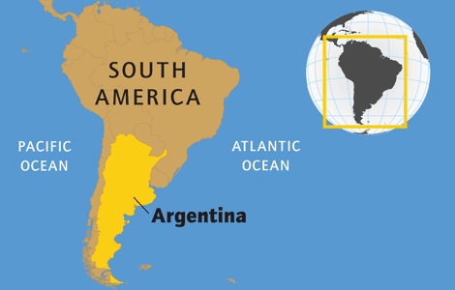
Early Life
Born into the aristocracy of Argentina.
Studied to become a doctor.
After graduation, spent eight months traveling Latin America.
Met Castro in 1955.

Slide 4
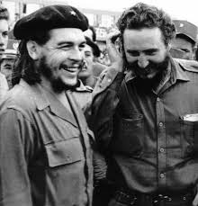
Relationship with Castro
Once described as . . . “It was like Lenin and Trotsky, like Hitler and Goebbels, lie Mao Tse-Tung and Zhu De” (Geyer).

Slide 5
Relationship with the Soviets
Initially, Che influenced Castro to align himself with the Soviets against the U.S.
After the Soviets removed the missiles following the Cuban missile crisis, Che began undermining the authority of the Soviets by blatantly describing them as a contributor to imperialism.

Slide 6
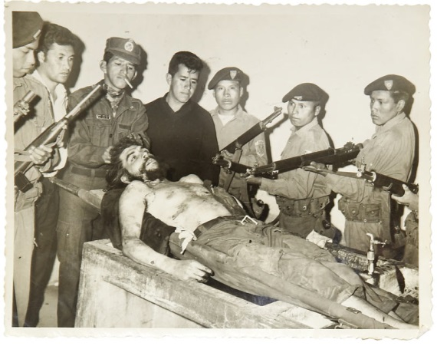
Remainder of His Life
Vietnam, the Congo, back to Cuba, then to Argentina, and finally Bolivia.
Unable to successfully lead revolutions.
Disillusioned, he was cut off from Castro.
1967 – CIA trained Bolivian Rangers capture and kill Che.

Slide 7
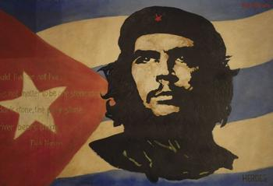
After Death . . .
Seen as a hero/martyr for the movement against imperialism in Latin America.

