Slide 1
5 Key concepts of sociolgy

Slide 2
Why 5 Concepts?

Slide 3
5 Concepts
S_c_al Str_c_r_
_o_ial A_ti_n
Functional Integration
P_w_r
C_l_ur_

Slide 4
Social Structure
Refers to patterns of
Social relationships
Social positions
Numbers of people

Slide 5
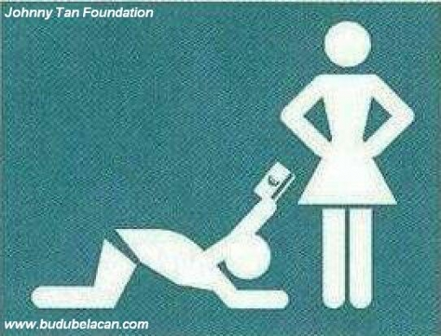

Slide 6
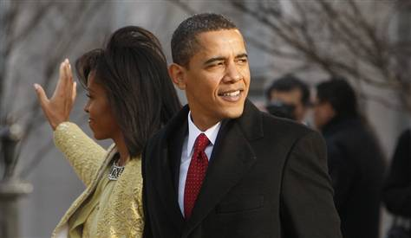

Slide 7
Other Examples of Social Structure

Slide 8
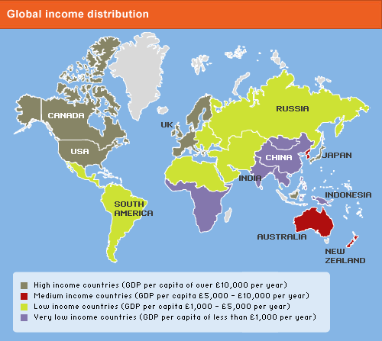
Another Example

Slide 9
Changing Social Structures

Slide 10
Adapting to Social Structure

Slide 11
Social Action
People’s behavior is based on meaningful understandings of what they do and is a response to actions of other people.

Slide 12
Why Is Social Action Important?
Almost everything we do depends on . . .
Communication
Leads to social groups

Slide 13
Actions/Social Component?

Slide 14
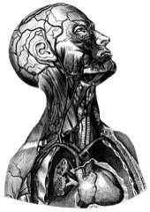
Functional Integration
Refers to the interdependence among the parts of the social system.

Slide 15
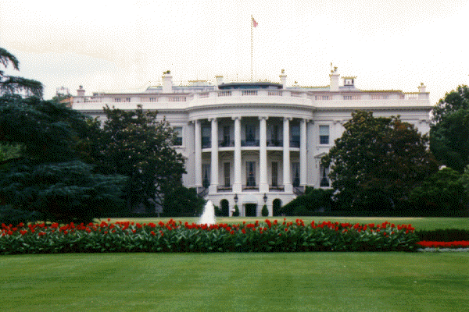
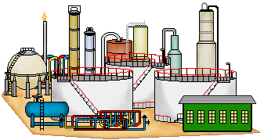
Example

Slide 16
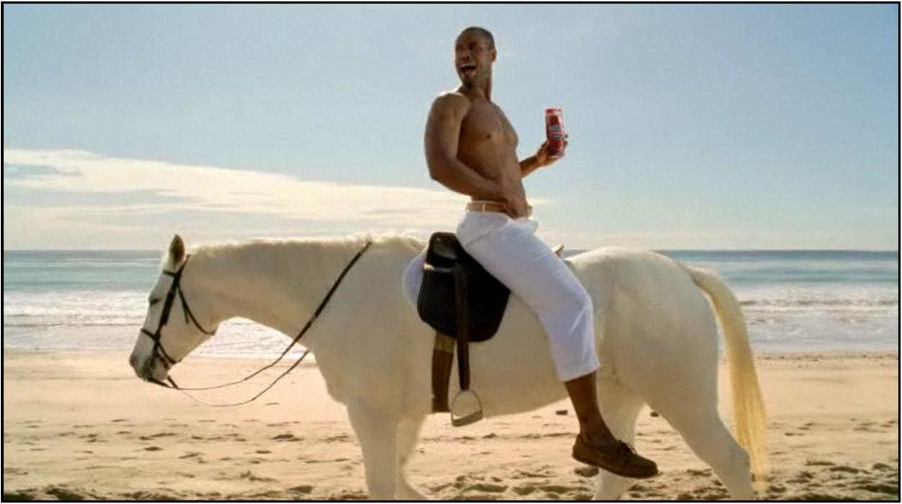
Dysfunctions of the human body?

Slide 17
Dysfunctions?

Slide 18
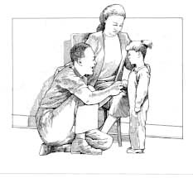
Power
The capacity of one social actor to get others to do its will.

Slide 19
Culture
Way of life; knowledge of “how to act”

