Slide 1
Social Stratification

Slide 2
Objectives
Describe social inequalities.
Define and measure social classes.

Slide 3
Bell Work
Social inequality
Social stratification
Life chances

Slide 4
Social Stratification
For many years, man lived in a class-less type of society.

Slide 5
Social Stratification (cont.)
As societies became more complex, the social system elevated entire categories of people above others.

Slide 6
Social Stratification (cont.)
Social stratification is defined as . . .

Slide 7

Four Basic Principles
Social stratification is a characteristic of society, not simply a reflection of individual differences.

Slide 8

Four Basic . . . (cont.)
Social stratification persists over generations

Slide 9

Four Basic . . . (cont.)
Social stratification is universal but variable.

Slide 10
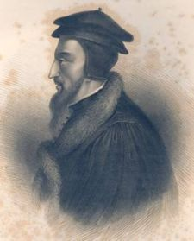
Four Basic . . . (cont.)
Social stratification involves not only inequalities but beliefs.

Slide 11
Caste System
Closed form of social stratification
Caste membership is an ascribed status
Endogamy
Ritual pollution

Slide 12
Caste System (cont.)
Historically quite common
Today: Only two examples

Slide 13
Caste System—India
Brahmin
Kshatrya
Vaishya
Shudra
“Untouchables”

Slide 14
Class System
Open form of social stratification based on _______ status.
Class membership is based on _____ status.
Almost all societies have a form of a class system.

Slide 15
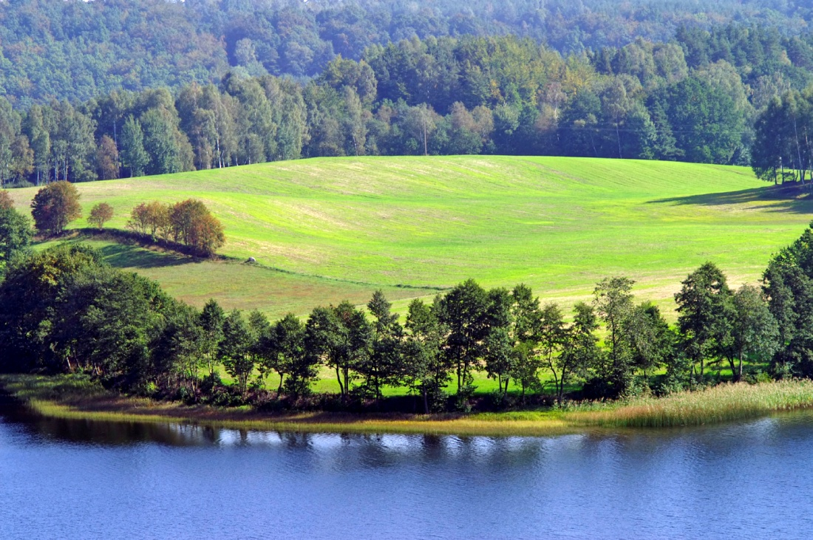
Agrarian Society
Small/wealthy class of landowners
Large/poor class of peasants

Slide 16
Industrialized Societies
Small and wealthy upper class
Fairly large middle class—white collar
Large working class—blue collar

