Slide 1
Migrating Tribes of Europe

Slide 2
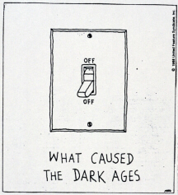

Slide 3
Decline of the Roman Empire
Loses power and control over conquered peoples
Allows freer movement for tribes
Leads to more attacks by invading tribes

Slide 4
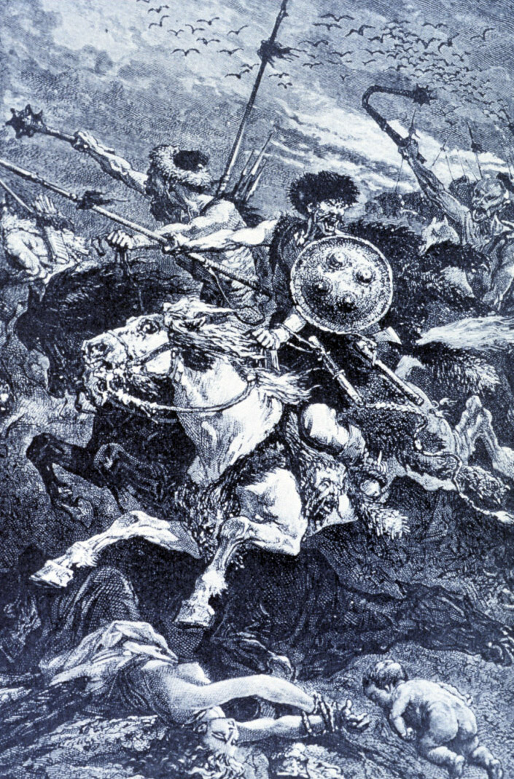

Slide 5
Migration of Tribes
Essential period for shaping the distribution of cultures in Europe and laying the ____________ for future European nations

Slide 6
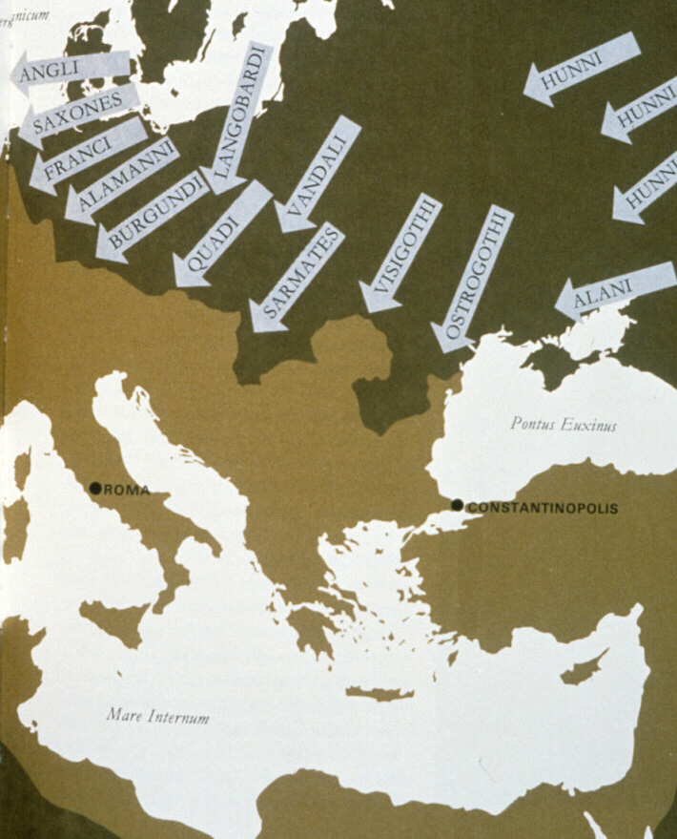

Slide 7
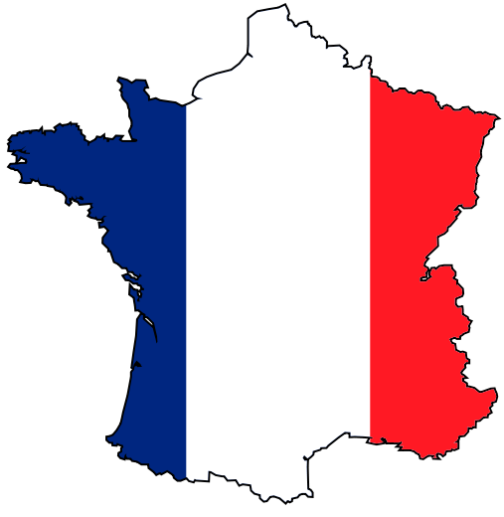
Migration of Tribes (cont.)
Tribes find fixed places to live
Franks and Burgundians = _____
Angles and Saxons = ______

Slide 8
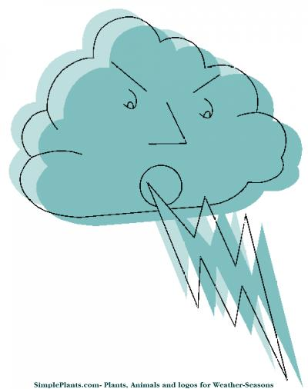
Causes of Migration

Slide 9
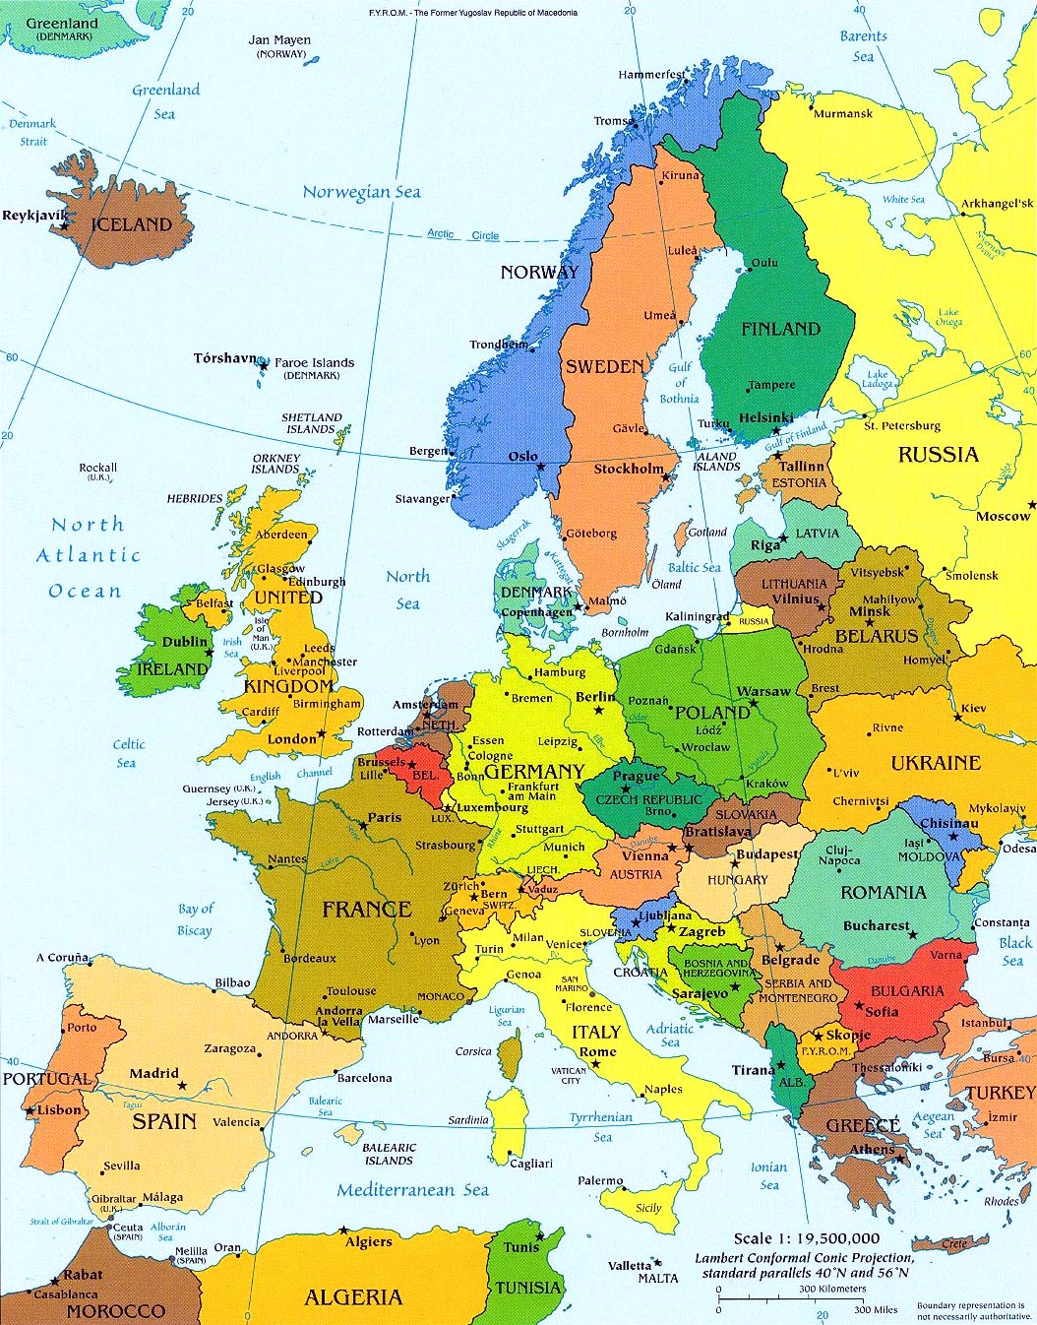
Consequences of Migration
Shaped future cultures/nations of Europe

Slide 10
Tribe Characteristics—Law
Tribal custom—NOT a legal code dictated by a government
__________ law
Law was applied to the TRIBE not the territory

Slide 11
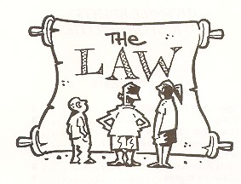
Tribe Characteristics—Oral Contracts
_________ statements were binding agreements

Slide 12
Tribe Characteristics--Comitatus
Honorable relationship between lords and vassals
_______—own land; have power and control
_______—rented land from lords

Slide 13
Tribe Characteristics—Trial by Ordeal
Settled disputes through tests—duels or battles
Believed God would dictate who was right and wrong

