Slide 1
Learning from Television

Slide 2
Cartoons
http://www.hulu.com/watch/31845/the-simpsons-no-more-cartoons
http://video.google.com/videosearch?hl=en&rlz=1T4ADBR_enUS271US289&q=roadrunner+and+coyote&oe=UTF-8&um=1&ie=UTF-8&sa=N&tab=wv&oi=property_suggestions&resnum=0&ct=property-revision&cd=1#hl=en&emb=0&q=violent%20bugs%20bunny&start=0
http://www.dailymotion.com/video/x154zw_1941woody-woodpecker-pantry-panic_fun

Slide 3
Bell Work
Growing up, what was your favorite t.v. show? Why was it your favorite t.v. show?
Did you ever watch violent cartoons as a child? Examples?
What affect does television have on our behavior?

Slide 4
Objectives
Describe how humans learn via observation.

Slide 5
Learning from Television
Close your eyes. Picture a news anchor in your mind.

Slide 6
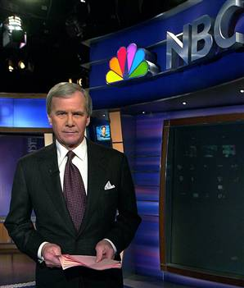

Slide 7
Learning from Television
Does t.v. make us racist?
Look at pie graph on p. 188

Slide 8
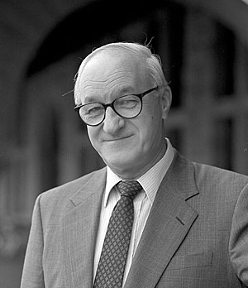
Albert Bandura

Slide 9
Albert Bandura
Children observed an adult hitting an inflated “Bobo Doll.”
Children observed a non-aggressive adult.
Children placed in a setting with no adult.

Slide 10
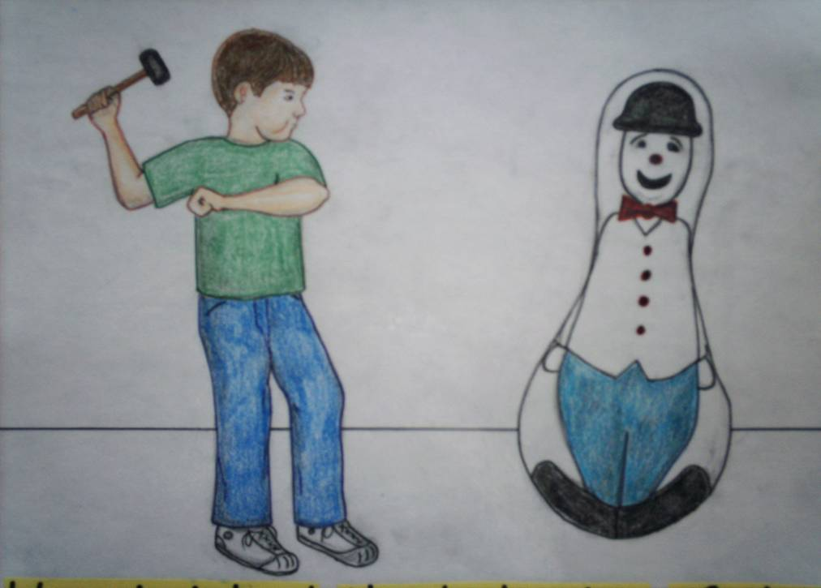
Result?

Slide 11
More Experiments
Children were exposed to . . .
An aggressive model in a live situation
A filmed version of the same situation
A cartoon version placed in fantasyland
Which setting cause more aggressive behavior?

Slide 12
Other Sources of Violence?

Slide 13
Other Sources?
Music Videos
Advertisements

Slide 14
Other Questions
What if a televised scene of violence is followed by consequences?
How does this affect us on into adulthood?

Slide 15
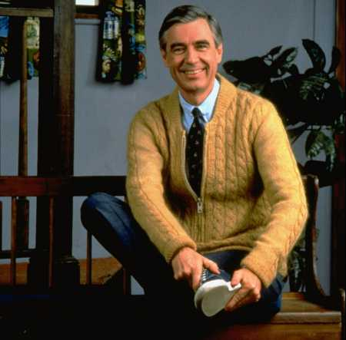
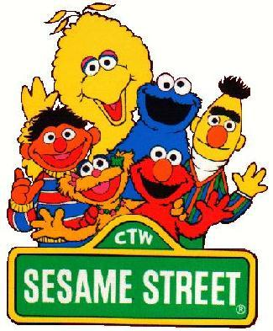
Any Positives?

