Slide 1
Intro to Rome

Slide 2
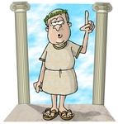
introduction
What is the most important concept we gain from the Greeks?
What is the most important concept we gain from the Romans?

Slide 3
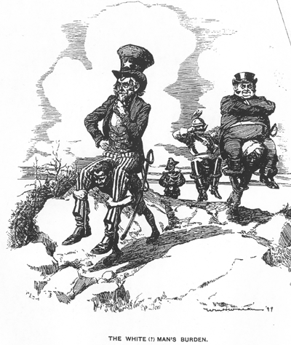
Rome
The Romans act as ______ agents and laid the ____ on which nations would be formed.

Slide 4
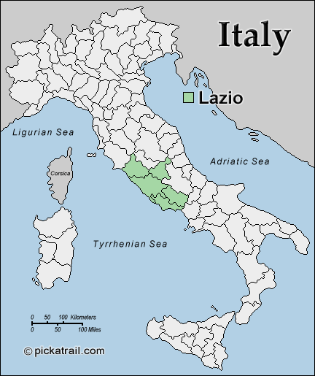
Location

Slide 5
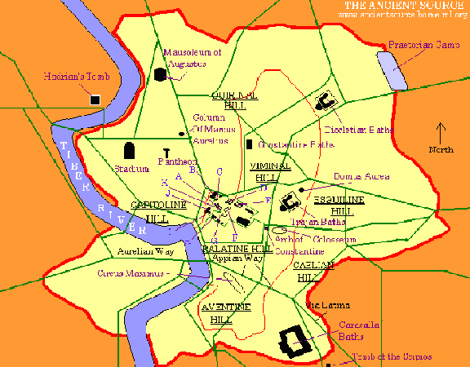
Location—tiber river

Slide 6
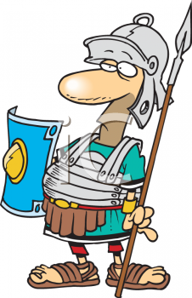
“All Roads lead to Rome”
What leads to Rome’s conquest of neighbors?
Central location
Accessibility
Relative poverty

Slide 7
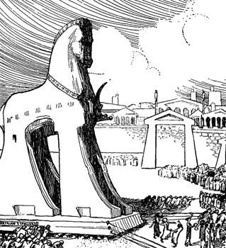
Mythological Origins
Survivors of Troy
Romulus and Remus
Sons of Rhea Silvia

Slide 8
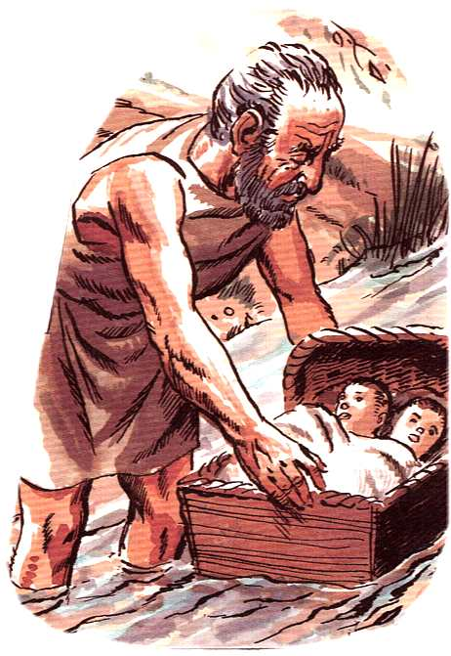
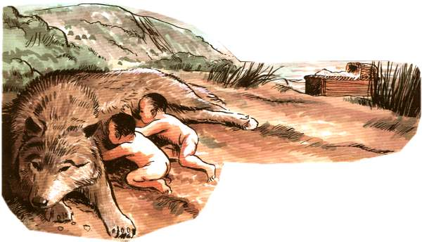
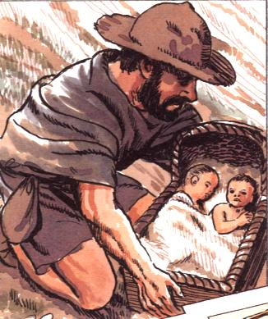
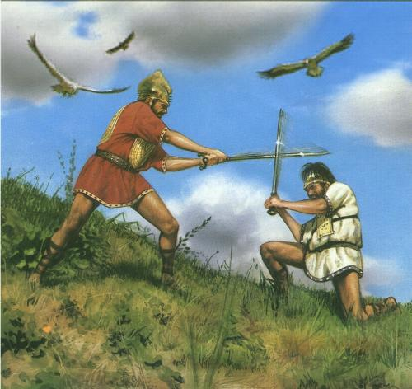
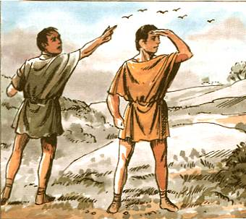
Romulus and Remus

Slide 9
Early Rome
Founded in ____ B.C.
Began as a small villages on a group of ___ hills on ___ River
Early settlers: farmers and herdsmen

Slide 10
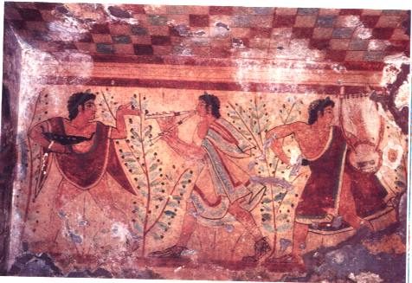
Early Rome
Between 800-700 B.C., Rome was conquered by the Etruscans.

Slide 11
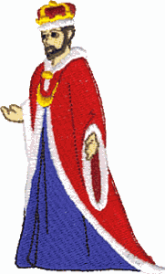
Etruscan Rule
Transformed Rome into a singe city-state with a central government under a ___.

Slide 12
Establishment of the Republic
Rome had __ kings.
Each king was advised by elders called the ___ made up of __ men.
All Roman citizens belonged to __ assemblies.

Slide 13
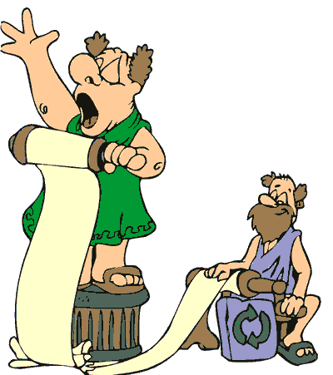
Roman Assemblies
Patricians—wealthy citizens
Plebians—bulk of population

Slide 14
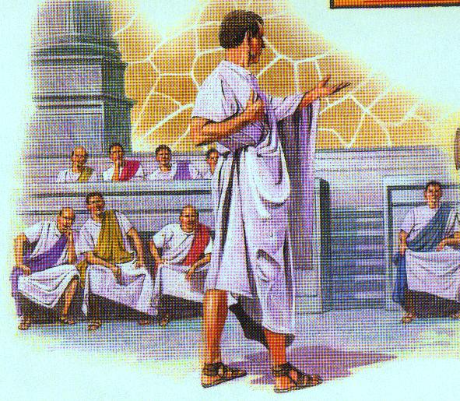
Republic
The development of a new sense of identity led to resentment of Etruscan rule.
509 B.C.—Patricians led a revolt and established a republic led by two annually elected consuls.

Slide 15
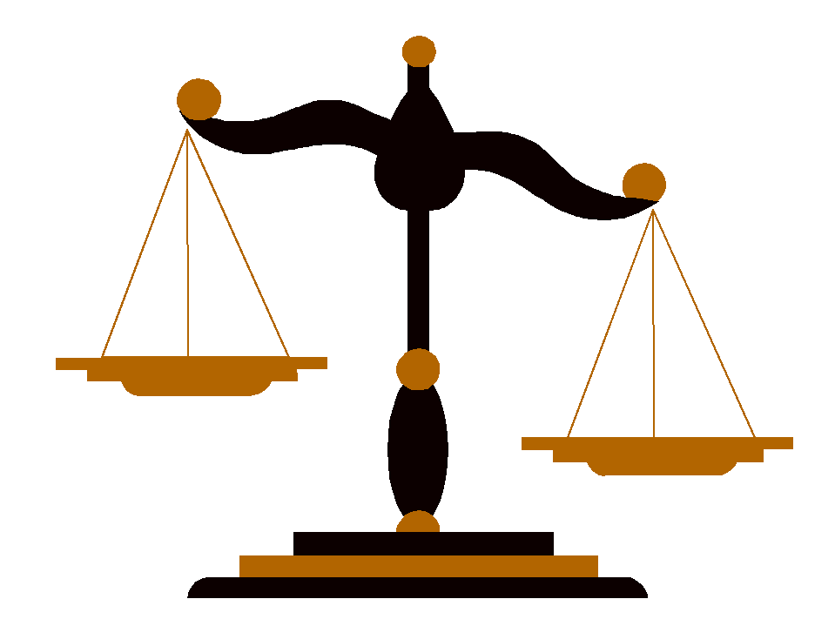
Struggle of the Orders
Plebians gained the right to elect a tribune who had the power to veto which created the Assembly of Tribes.
Plebians pressured patricians to writing down the law system—____ Tables.

Slide 16
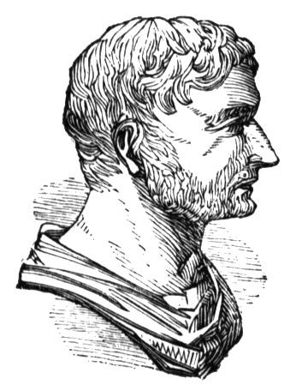
Equality?
Even though Rome was a representative democracy, a small group of wealthy families—nobles—actually held power.

