Slide 1
Emotion and the Brain

Slide 2
Objectives
Describe how the brain processes the emotion of fear.
Identify the purpose of a polygraph test.

Slide 3
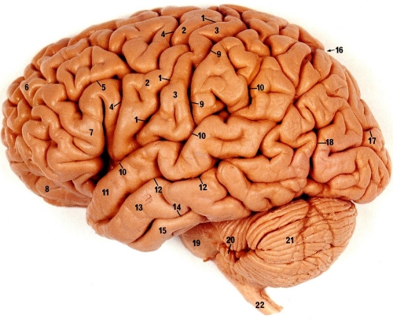
Emotion and the Brain
What part of the brain is associated with fear?

Slide 4
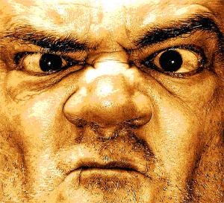
Emotion and the Brain (cont.)
When the amygdale is activated . . .

Slide 5

Emotion and the Brain (cont.)
Emotions can be lateralized.

Slide 6
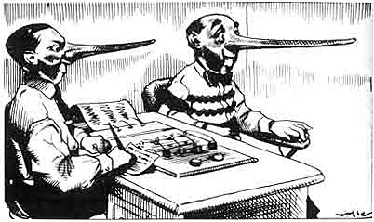
Polygraph Tests

Slide 7
Polygraph Tests (cont.)
Polygraph tests detect changes in . . .
  Heart rate
  Blood pressure
  Respiration rate
  Skin conductance response

Slide 8

How can you “beat the box”?
Become a habitual liar

Slide 9

How can you “beat the box”?
Don’t pay attention.

Slide 10
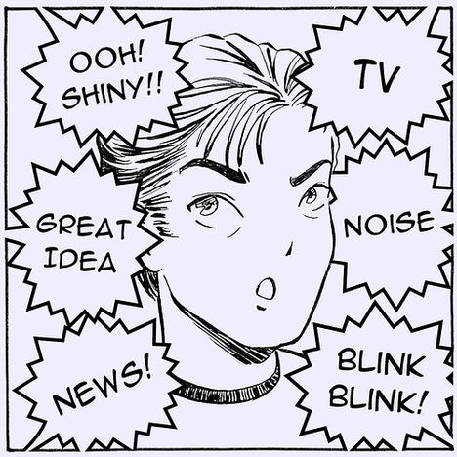
How can you “beat the box”?
Become distracted

Slide 11
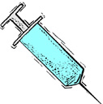
How can you “beat the box”?
Tranquilizers

Slide 12
How can you “beat the box”?
Tensing muscles and thinking about something exciting

Slide 13
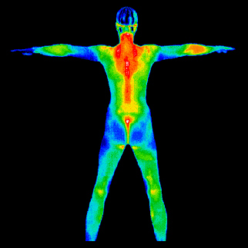
Alternative to Polygraph Tests

