Slide 1
Deviance and Social Control

Slide 2
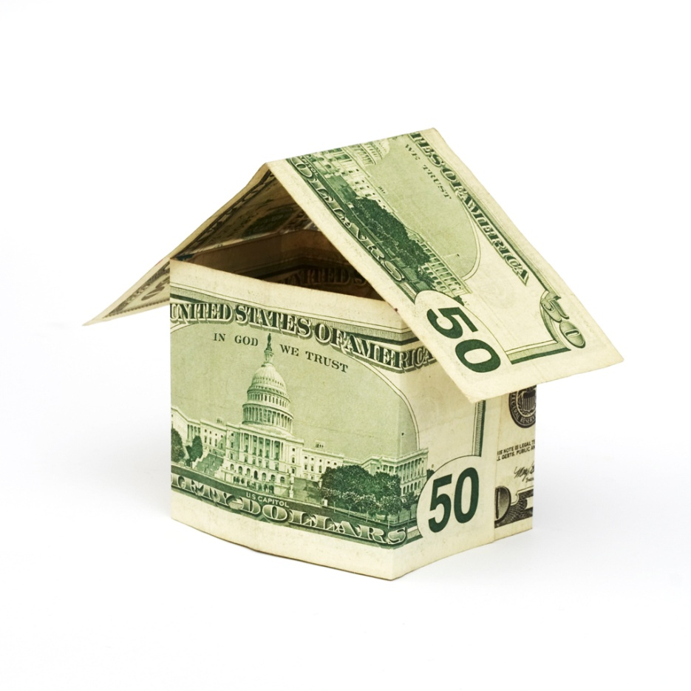
Introduction
Under most conditions, social behavior is . . .

Slide 3
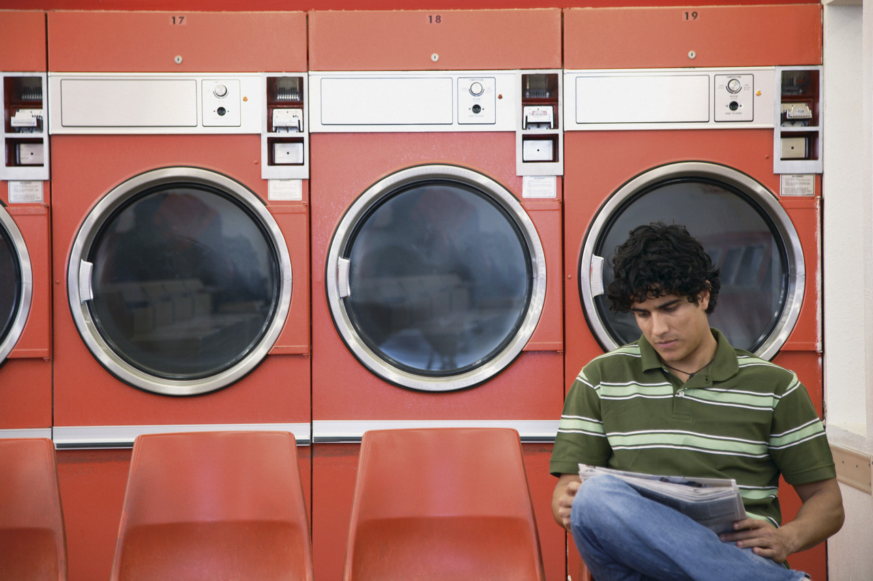

Slide 4
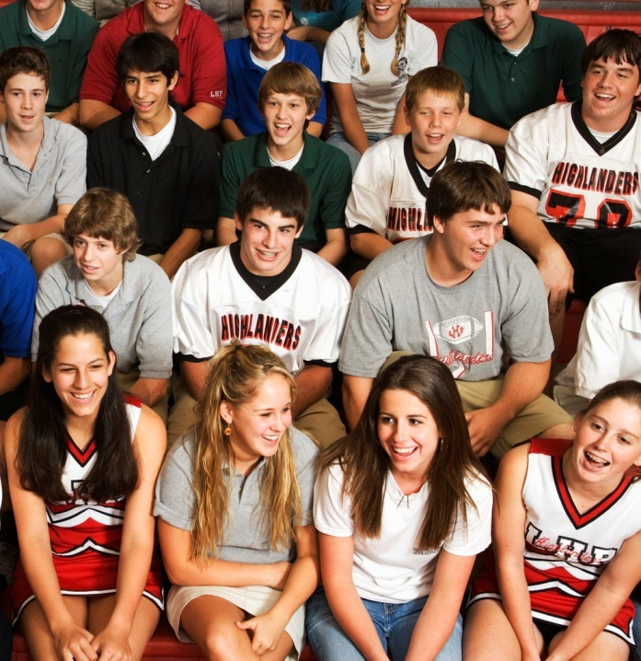
Social Order
Social order can only take place if there is a means of . . .
It starts with the ____ process.

Slide 5

Social Order
Most people conform to social norms and rarely question their own behavior.

Slide 6
Social Order
When socialization cannot guarantee social conformity . . .
  Rewards for conformity
  Punishment for non-conformity
  Formal/Informal

Slide 7


Slide 8
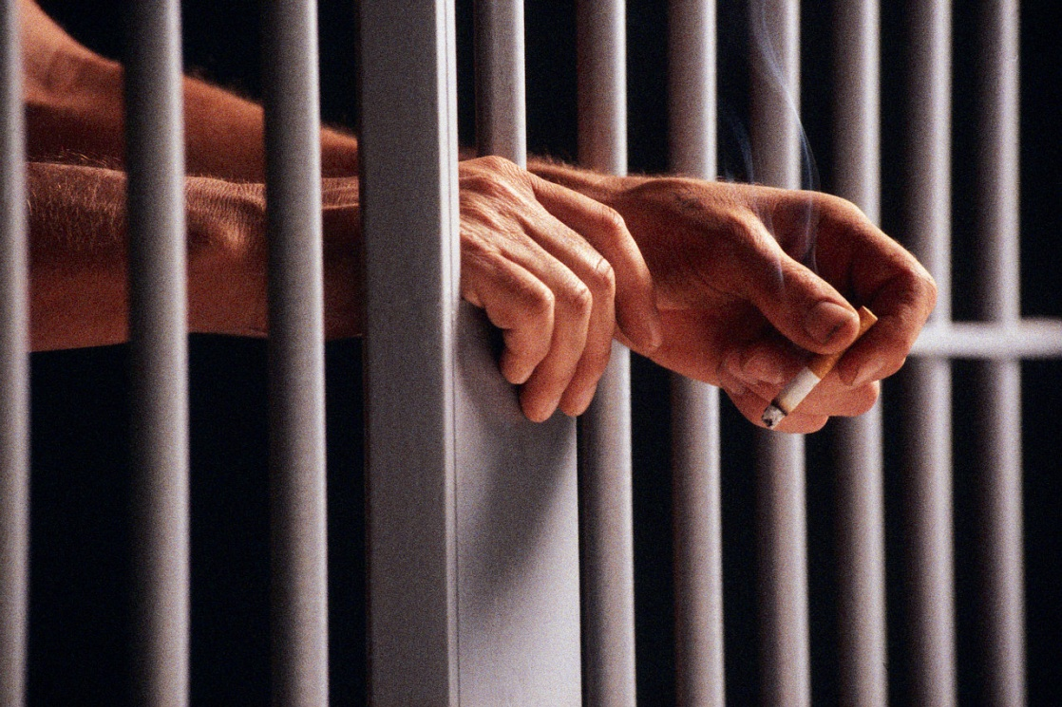

Slide 11
Social Order
Negative sanctions indicate that social control has _____ and ______ has occurred.

Slide 12
Positive side of Deviance?
What do you think of when you hear of . . .

Slide 13
Conclusion
When you apply sanctions to deviant behavior, you create an “us” vs. “them” scenario.

