Slide 1
Cognitive Learning

Slide 2
Bell Work
Insight
Latent Learning
Observational Learning
Modeling

Slide 3
Objectives
Analyze insight’s affect on learning.
Evaluate the necessity of reinforcement.
Describe how humans learn via observation.

Slide 4
Cognitive Processes
What are they?

Slide 5
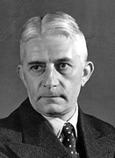
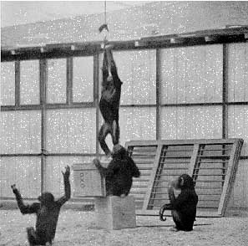
Learning by Insight
Wolfgang Kohler

Slide 6
Latent Learning
Have you ever learned something, but you were not motivate to use it?

Slide 7
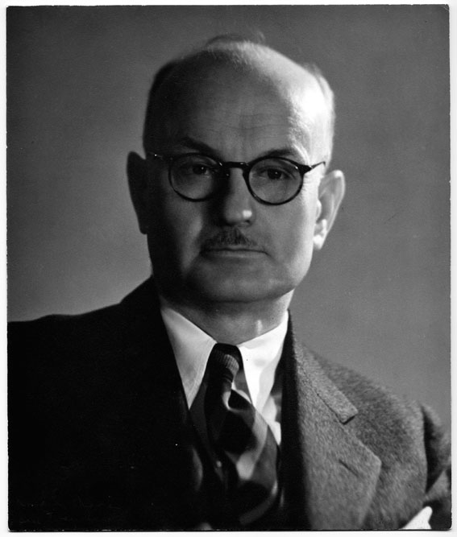
Latent Learning
Edward Tolman

Slide 8


Slide 9
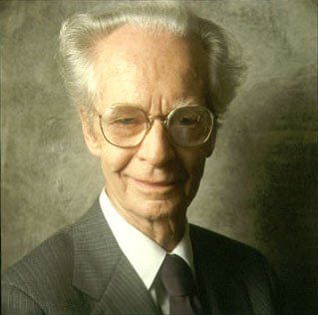
What does the prove?
B.F. Skinner was WRONG!

Slide 10

Observational Learning
Who’s your role model?

Slide 11
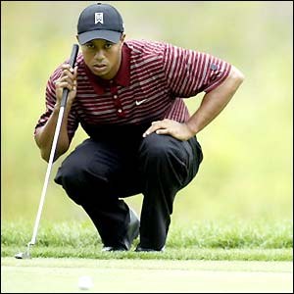
Observational Learning (cont.)
What can we learn from a role model?

Slide 12
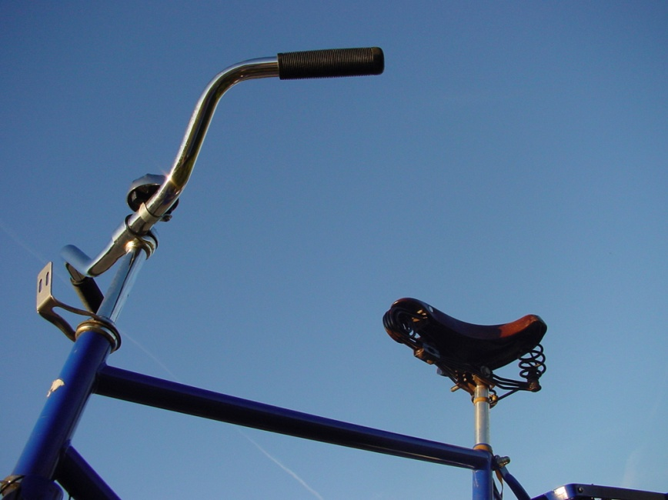
Modeling Effect
I do it; you watch me do it.
I do it; you help me do it.
You do it; I help you do it.
You do it; I watch you do it.

Slide 13

Eliciting Effect

Slide 14
Disinhibitory Effect

Slide 15
Inhibitory Effect

