Slide 1
Arab-Israeli Conflict

Slide 2
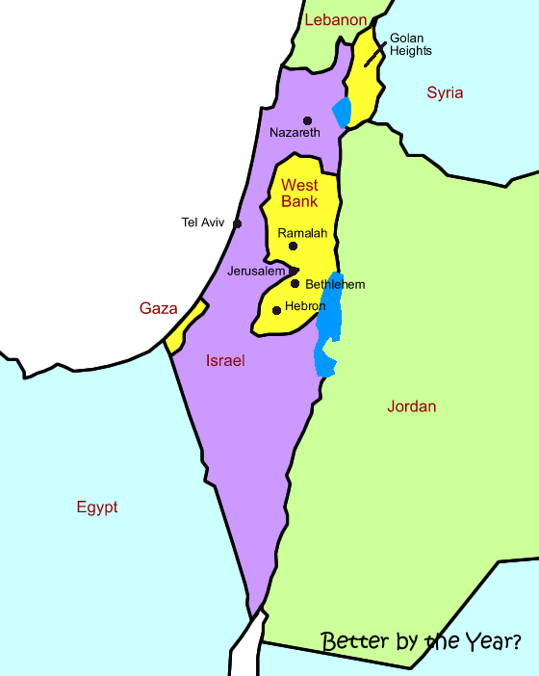

Slide 3
Reasons for Conflict
Religion, Ethnicity, and Culture
Land, Property, and Water
Diaspora
History

Slide 4
The Creation of Modern Israel
Zionism
Balfour Declaration (WWI)
Holocaust and WWII
British Control vs. U.S.
Control

Slide 5
Partitioning of Palestine
West Bank
Gaza Strip

Slide 6
Israel @ War
Arab-Israeli War (1948)
Six Day War (1967)
Yom Kippur War (1973)

Slide 7
Attempts @ Peace
Shuttle Diplomacy
Camp David Accords
Oslo Talks

Slide 8
Other Sources of Conflict
PLO—Yassar Arafat

Slide 9
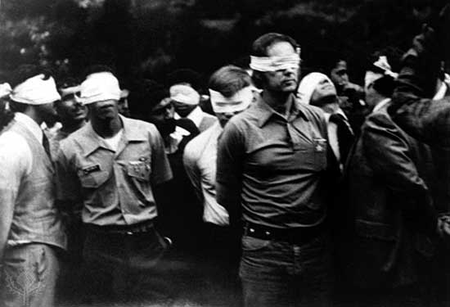
Other Sources of Conflict
Iranian Hostage Crisis

Slide 10
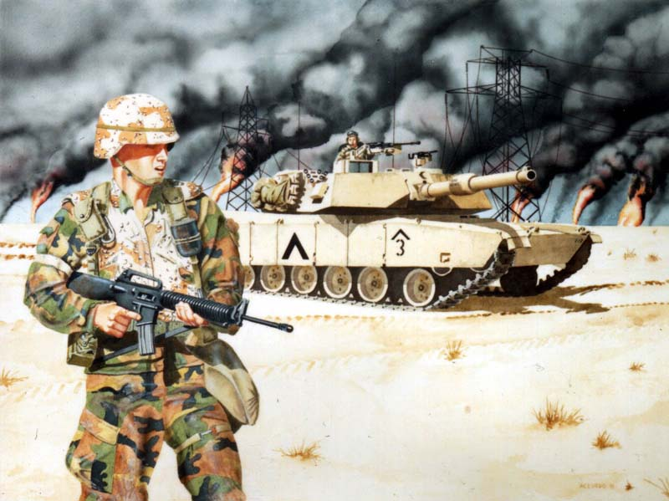
Other Sources of Conflict
Iran/Iraq War
Persian Gulf War

