Slide 1
Ali Baba and the Forty Thieves

Slide 2
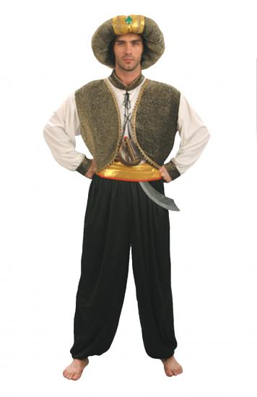
Arabian Nights
Collection of Arabian, Indian, and Persian stories

Slide 3
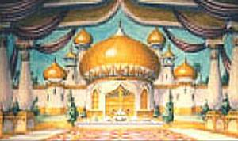
The Frame Story
King Schahriah
The bride-Scheherazade

Slide 4
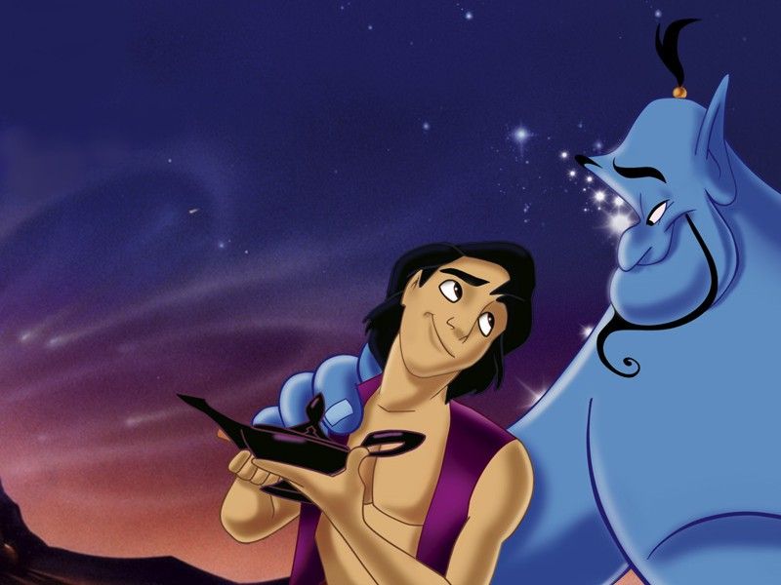
Other Stories
“The History of Aladdin”
“The History of Sinbad the Sailor”

Slide 5
Chart
Similarities to our culture | Characteristics of Ali Baba | Characteristics of Cassina

